Slide 1
Store Manager
Team: C03(CSE-C)
Mentor: Dr K Vinuthna
M Arya Sri Ganesh(245318733155)
M.V.S.Pranavi(245318733153)
G Vishal(245318733139)
Mobile Application Development

Slide 2
Contents
Introduction
System Design
Software Requirements Specifications
Project Technicalities
Developed Modules

Slide 3
Introduction
Store manager is an android application which stores and controls stock related information in the stores and also allows management to generate statistical data like annual sales, annual profit along with generation of bill to the customer.

Slide 4
Need Of Application
Competition is rapidly growing in business requiring entrepreneurs to create product excellence and to study the behavior of consumers.
Technological developments enable employers in small, medium and large companies to do business by using Internet.
Now the development of Internet can be integrated with mobile devices such as mobile phones to make the flow of information more widely
This application facilitate employee of stores in organizing, processing, monitoring the movement of inventory items that occurred in the stores.

Slide 5
Proposed System
It is totally mobile-based application which makes use of internet and a database to provide following services to the management of the stores :
Maintaining stock
Monitoring the movement of stock
Identifying the products which are nearing the expiry date
Identifying the products whose stock is about to be finished
Calculating annual statistics like annual sales & annual profit

Slide 6
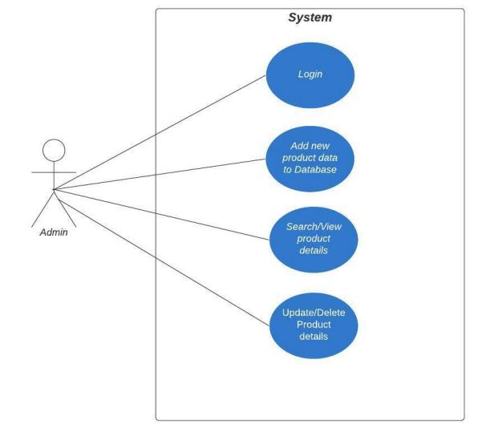
System Design
Use Case Diagram

Slide 7
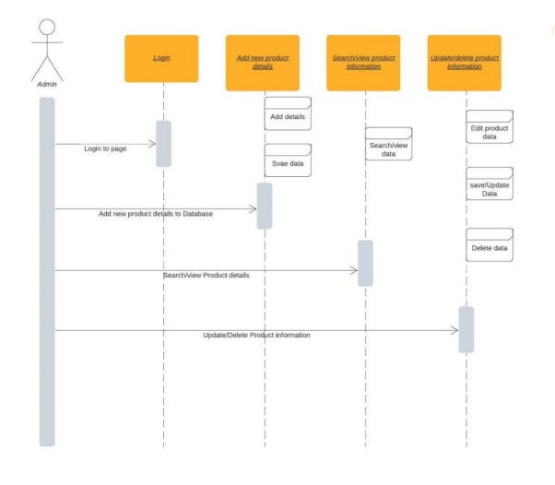
Sequence Diagram

Slide 8
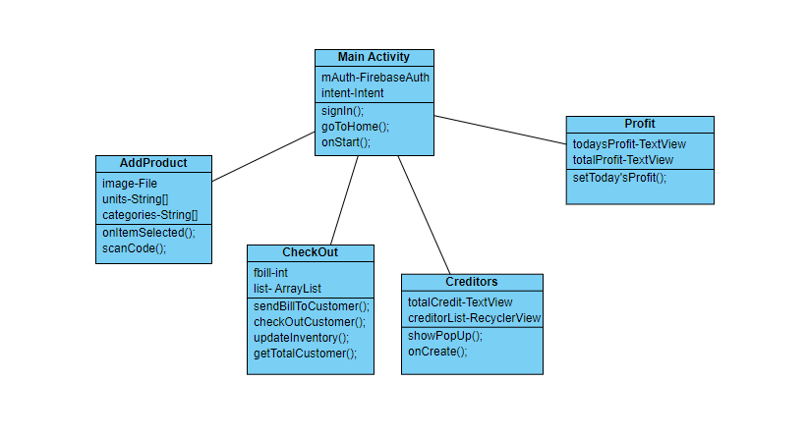
Class Diagram

Slide 9
Software Requirements Specification
Software Requirements
Hardware Requirements
Functional Requirements
Non - Functional Requirements
Project Technicalities

Slide 10
Software Requirements
Java
Android Studio IDE

Slide 11
Hardware Requirements
System Configuration To Develop Application
Minimum Requirements:
OS : Windows or Linux Or Mac
Processor : 3.0 GHz
RAM : 8 GB
Graphics Card : 2 GB (Optional)
Basic : Keyboard, Mouse, Internet
Mobile Configuration To Run The Application
Minimum Requirements:
OS : Android os
Android version : 4.0.0 (Ice Cream Sandwich)
RAM : 2 GB
Camera : 5 MP
SD Card : 2 GB

Slide 12
Functional Requirements
Login With Google
Storing Stock Details To The Database
Displaying Stock Details
Generating Bill
Calculating Annual Statistics
Storing Transaction Details
Managing Creditors Account

Slide 13
Non - Functional Requirements
Accurate Results
Availability
User - Friendly Interface
Easy To Maintain
Bug - Free

Slide 14
Project Technicalities
Front - End Technologies :
Android Studio IDE
XML
Back - End Technologies :
Java
Firebase Firestore
Firebase Storage
Firebase Authenticate

Slide 15
Thank you !!

